Slide 1
GPK.Battles Game
Testing Report
Abhijit Roy

Slide 2
Content
Run-1
Run-2
Run-3
Run-4
Run-5
Run-6
Run-7
Run-8
Run-9
Run-10

Slide 3
RUN-1

Slide 4
Workflow
START
transfer desired cards to escrow contract
ACTION -> `simpleassets::transfer`
Select cards for playing
Reason: Ensure `game_fee` in `gfeewallet` table
---------------------------------------------------------------------
Solution: transfer min. required `game_fee` from `eosio.token::accounts` table
ACTION -> `eosio.token::transfer`
ACTION -> `gpkbattlesco::sel3card`
play
During 1st trial
If (1st trial & 1-Draw): 1 time draw
Both players get 1 last chance to select cards & play again for free
From Table | To Table
eosio.token::accounts | gpkbattlesco::gfeewallet
ACTION -> `gpkbattlesco::play`
No Draw
1-Draw
ACTION ->
`gpkbattlesco::receiverand`
During 2nd trial
After both players select cards
After no players select cards
After 1 player select cards
Disburse nodraw cards
ACTION ->
`gpkbattlesco::disndcards`
ACTION ->
`gpkbattlesco::del1drawgame`
ACTION ->
`gpkbattlesco::del1drawgame`
2-Draw
END

Slide 5
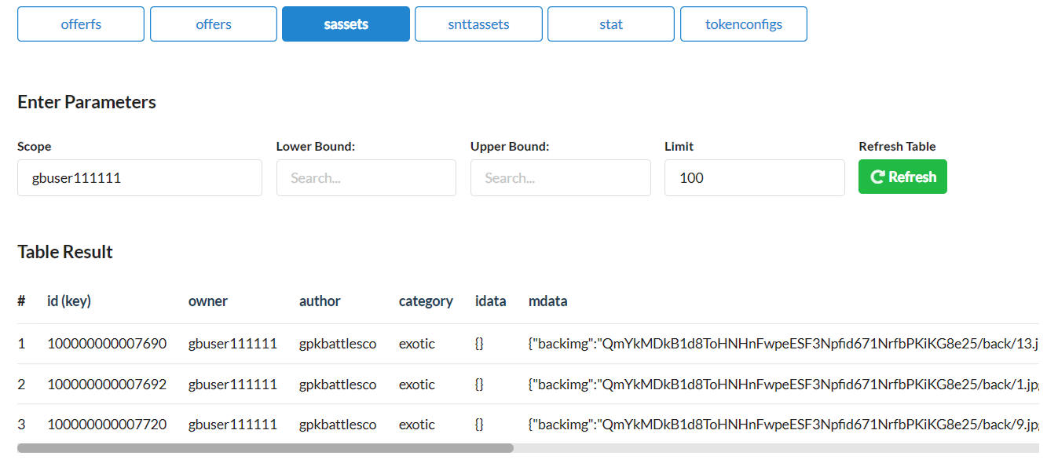
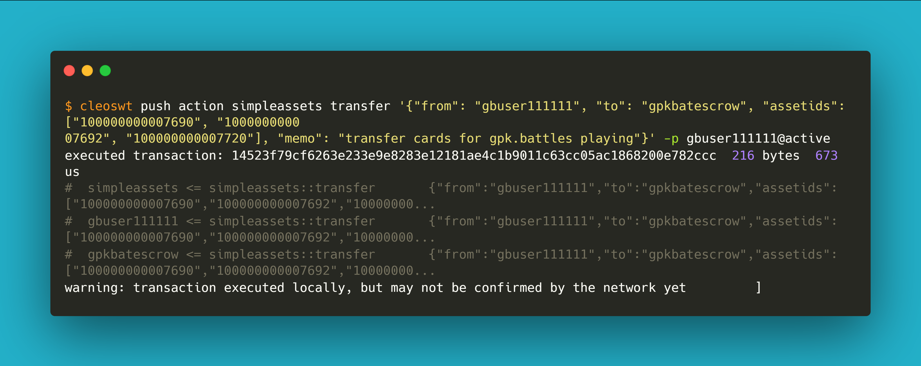
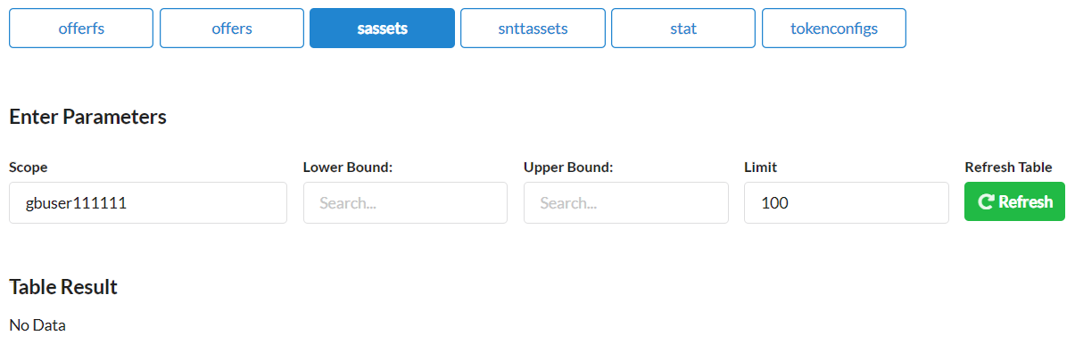
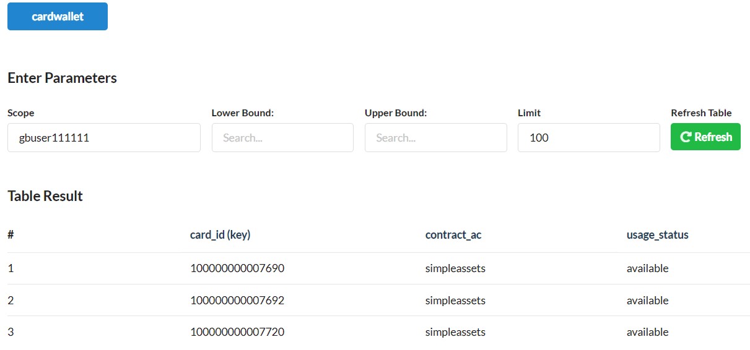
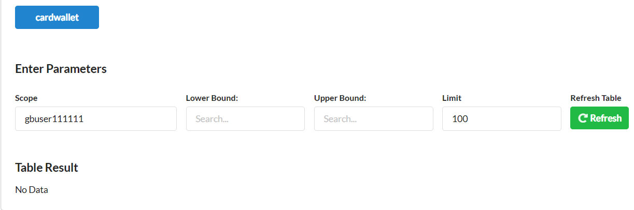
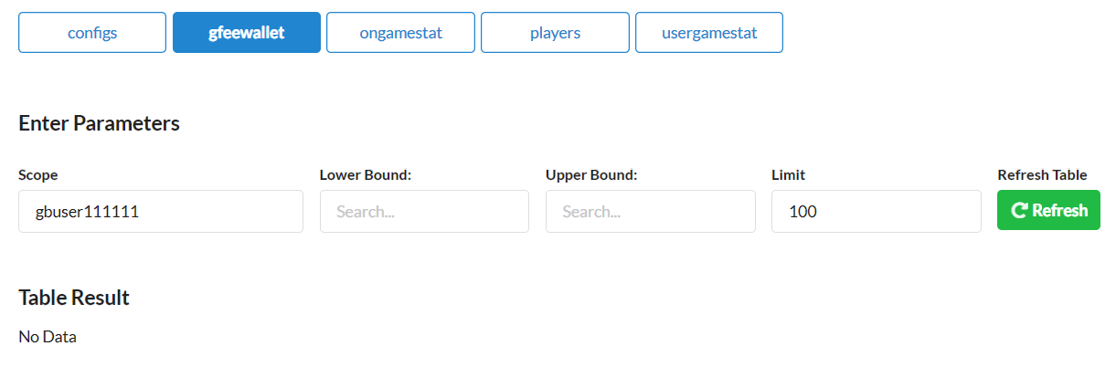
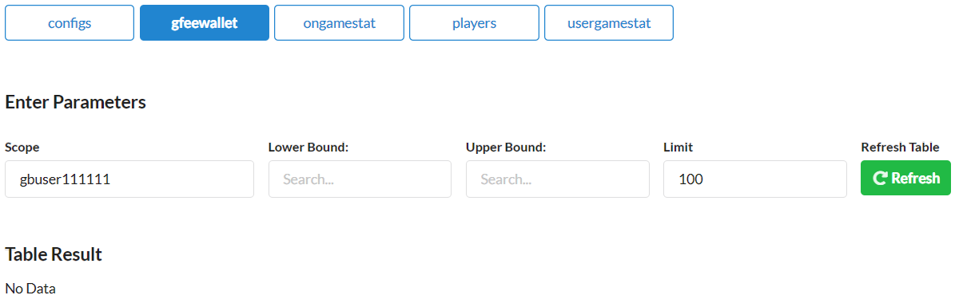
1.
gbuser111111
transfer desired cards to escrow contract
gpkbatescrow
Pre
Activity
Post
sassets
sassets
cardwallet
cardwallet
gfeewallet
gfeewallet

Slide 6
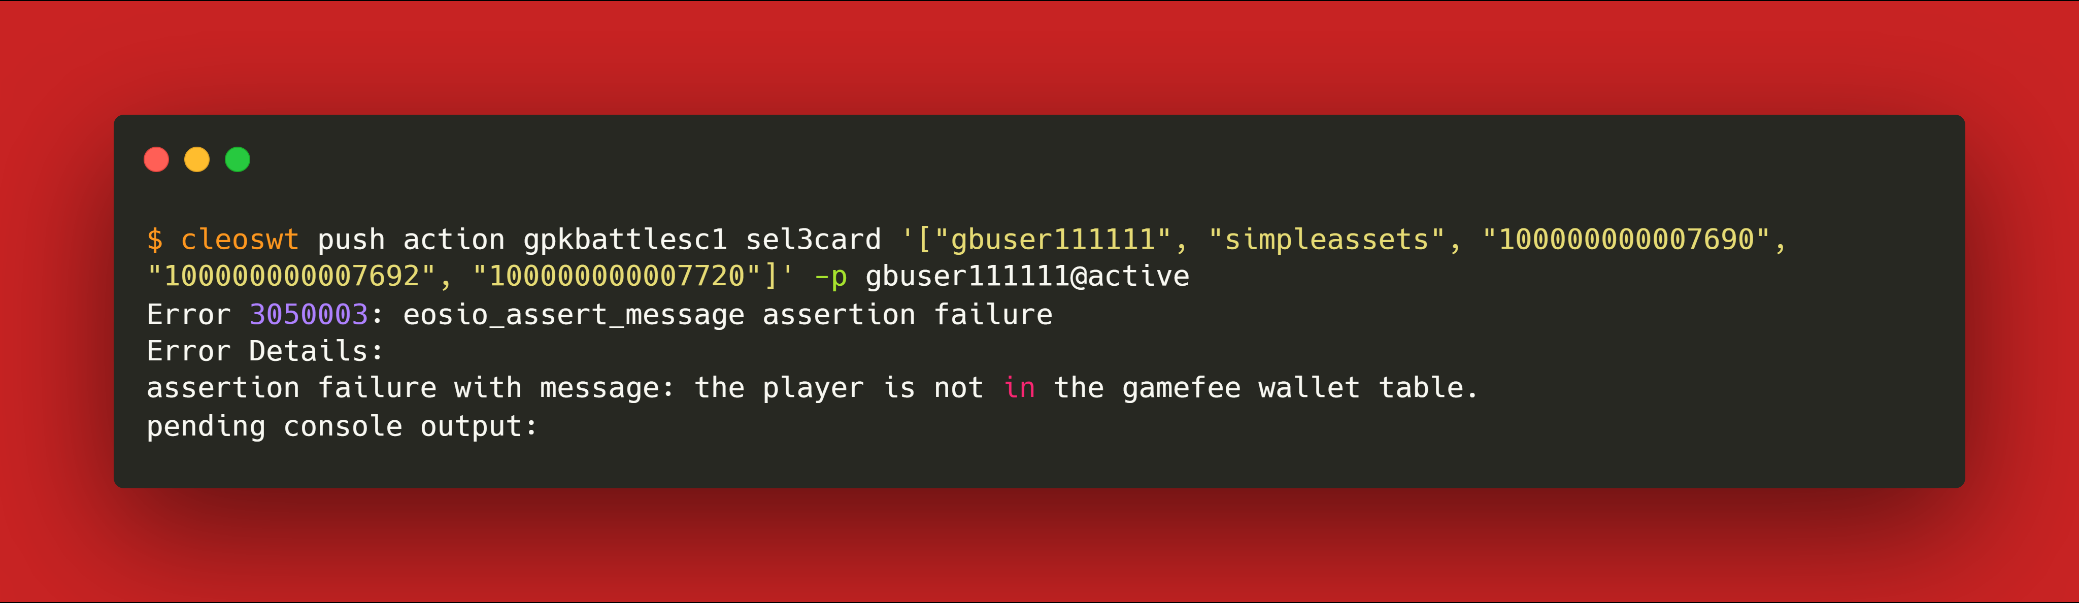
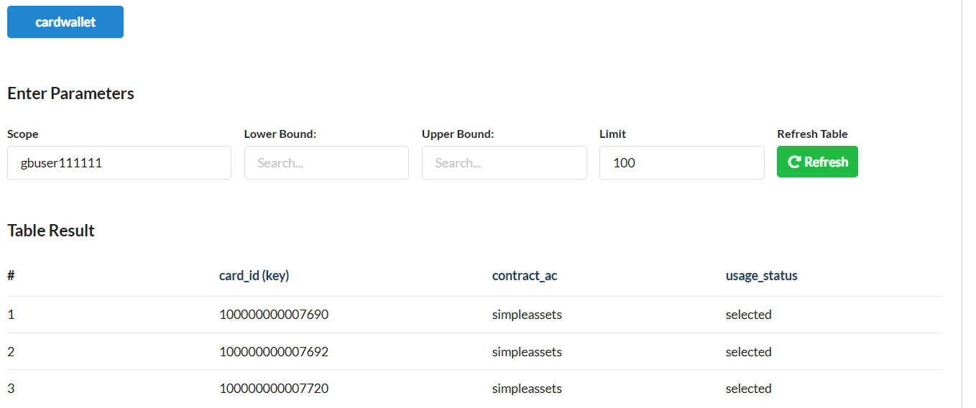
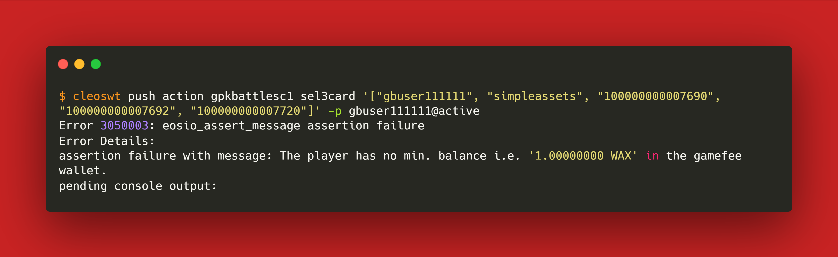
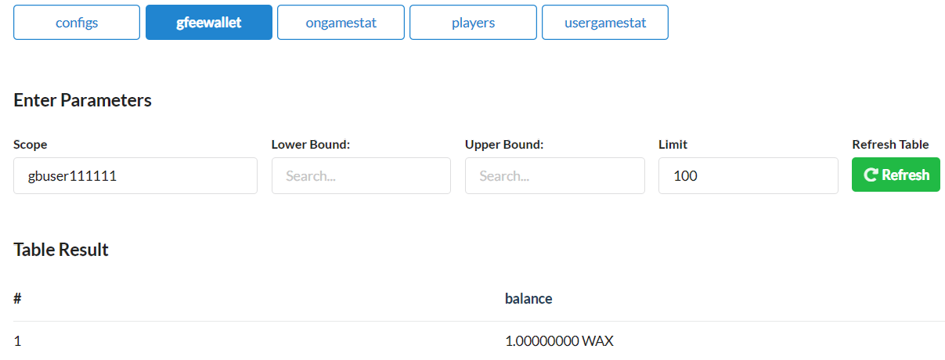
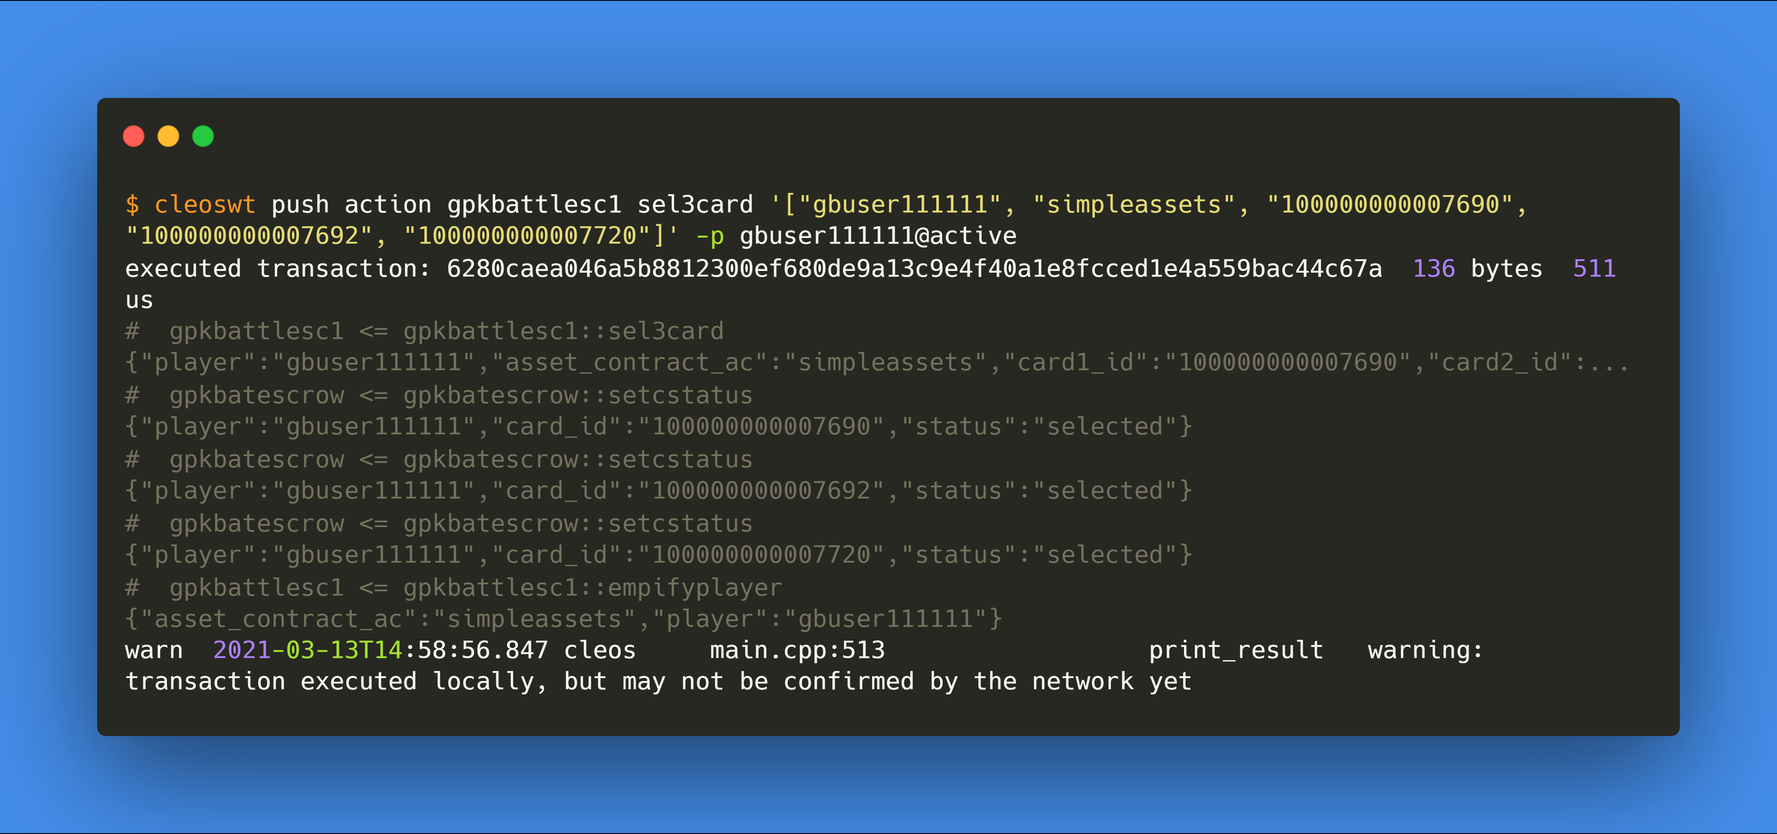
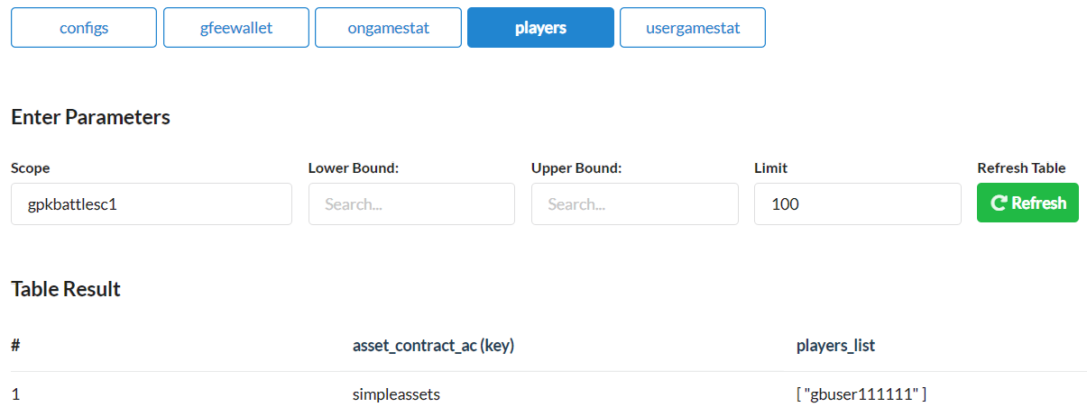
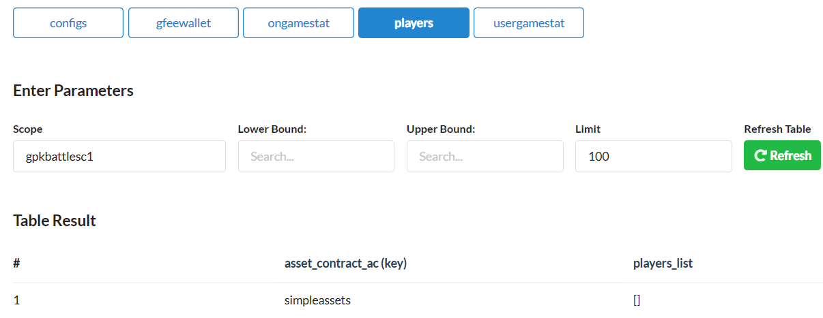
2.
gbuser111111
select 3 cards
Pre
Activity
Post
cardwallet
cardwallet
gfeewallet
gfeewallet
players
players

Slide 7
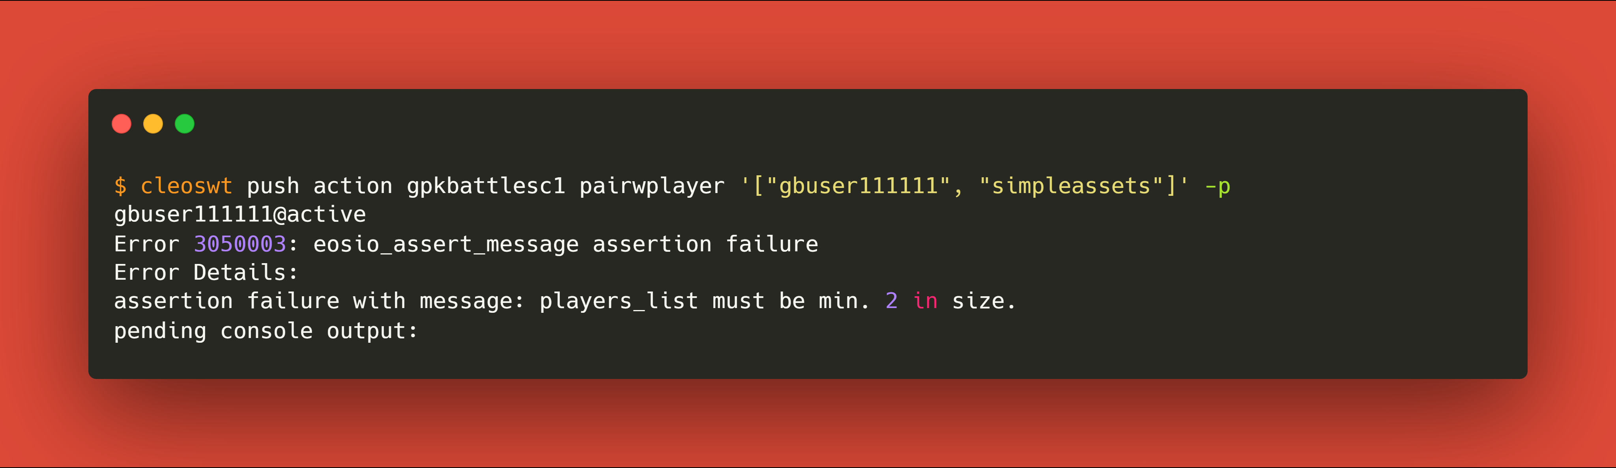
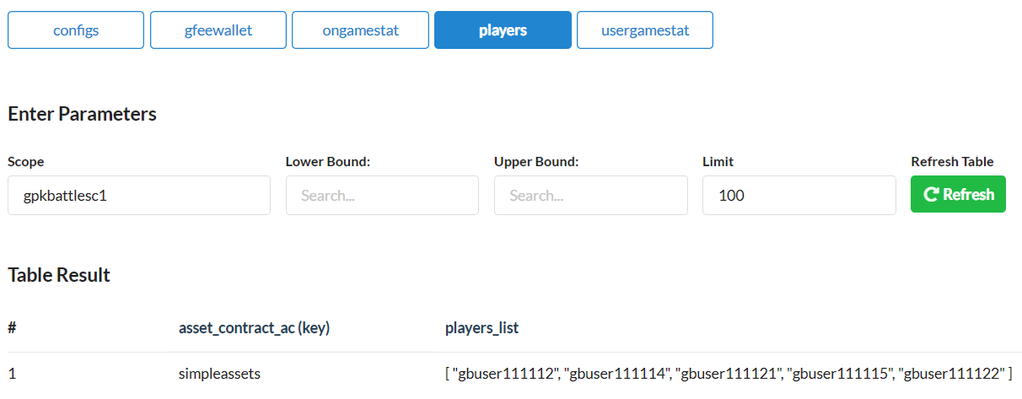
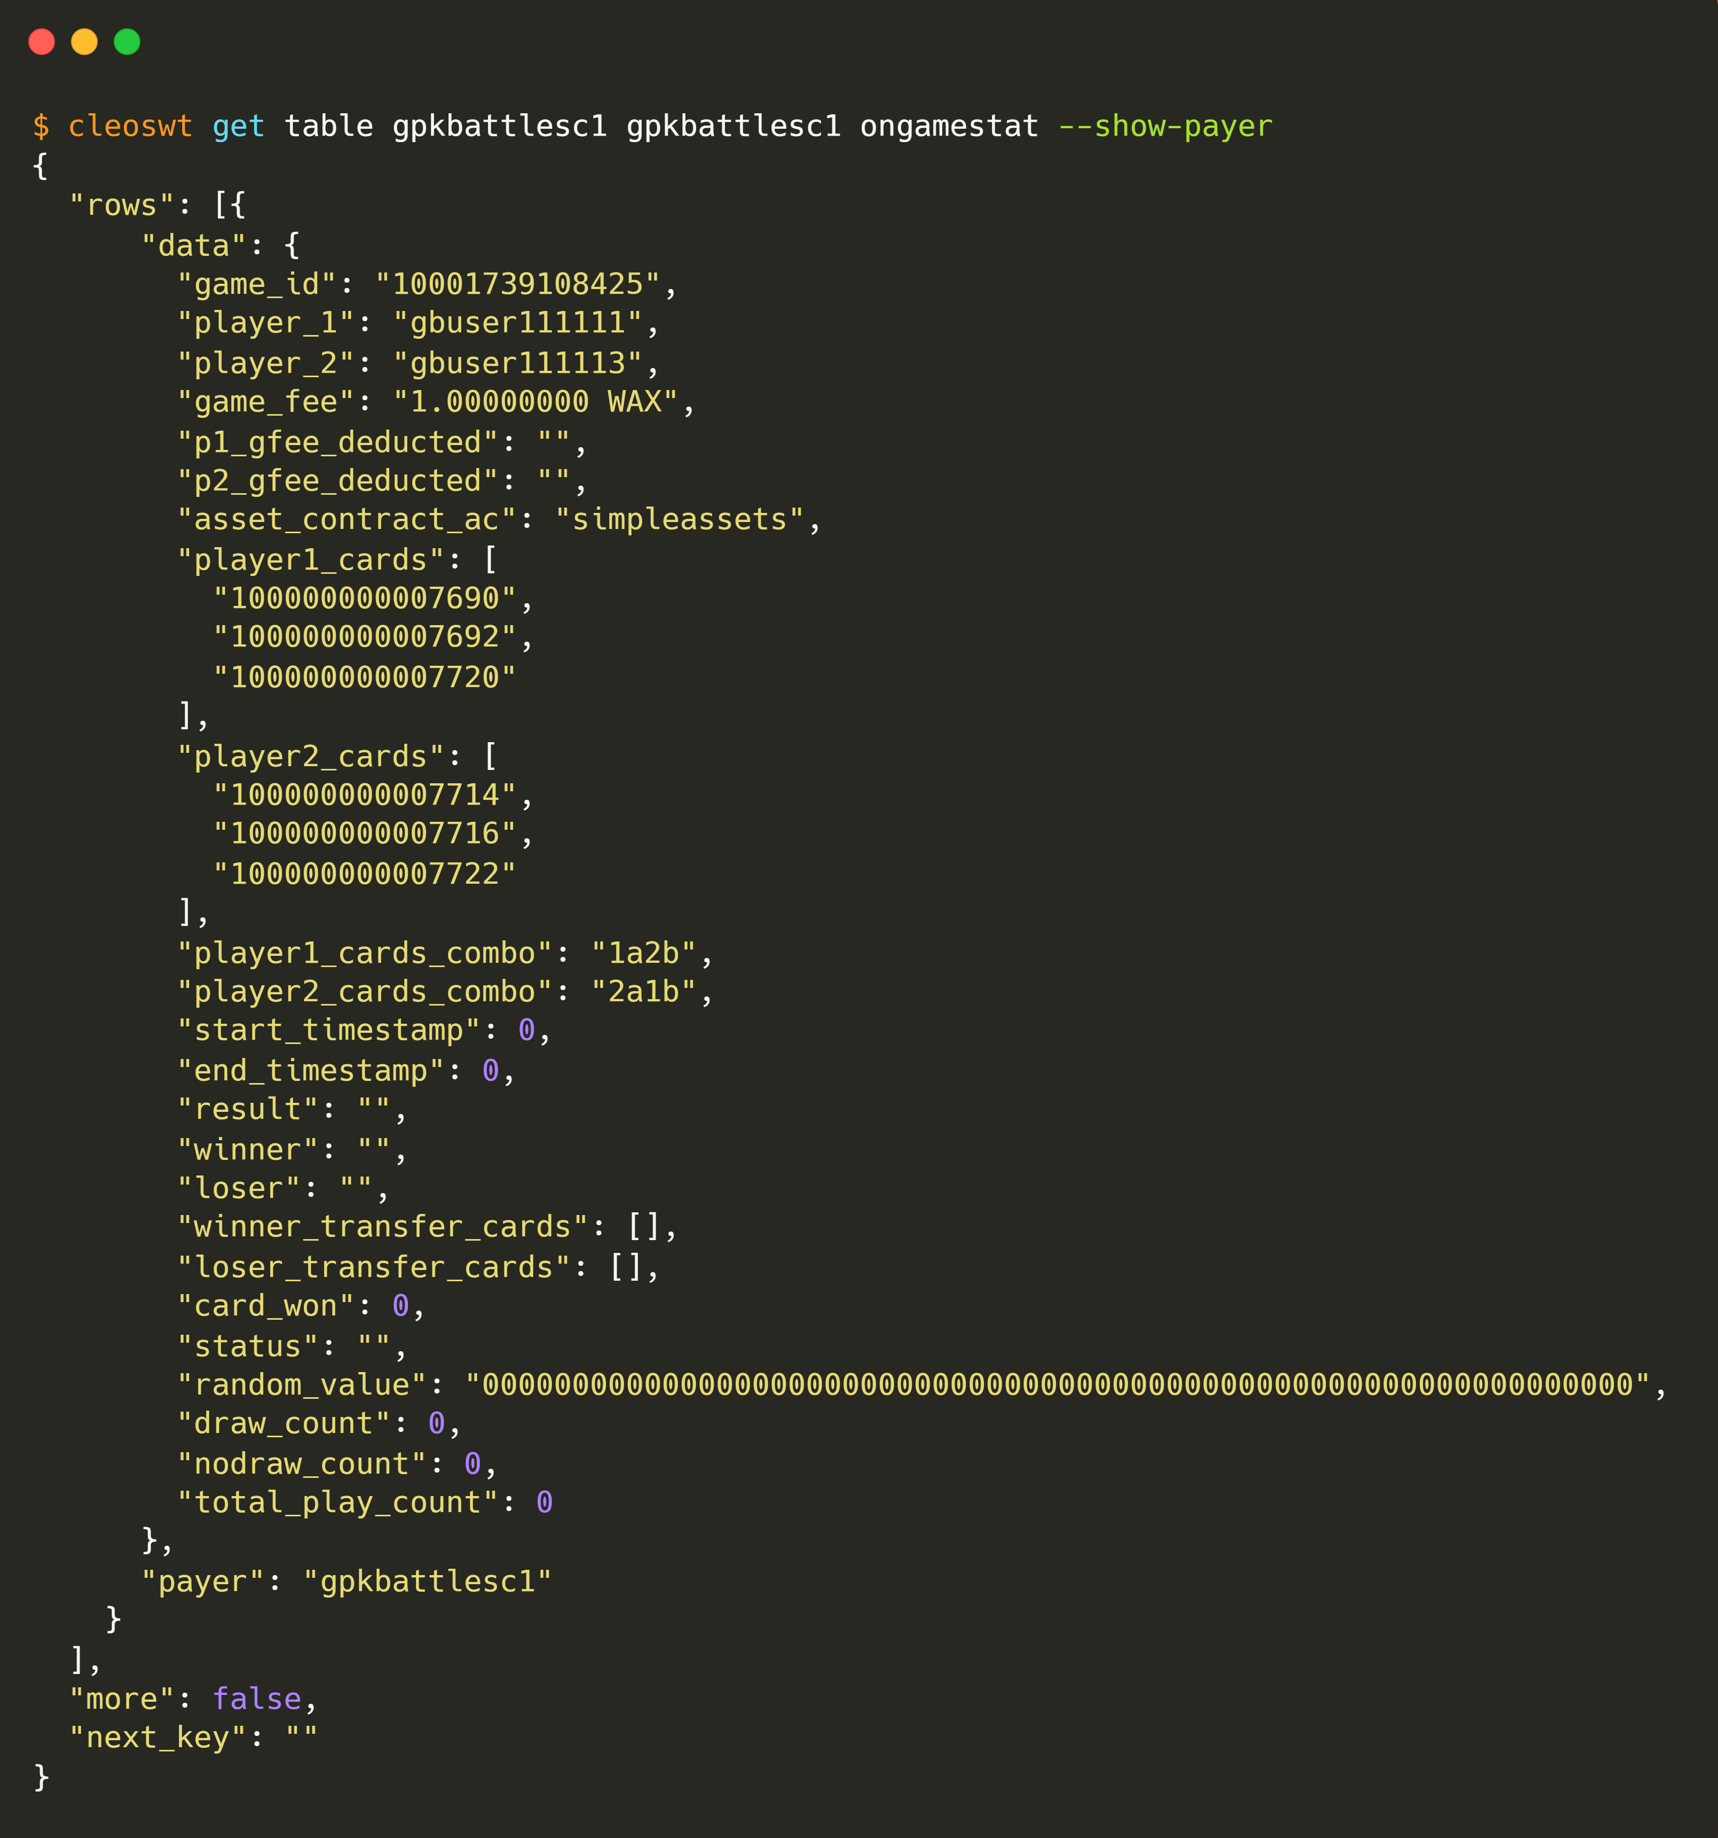
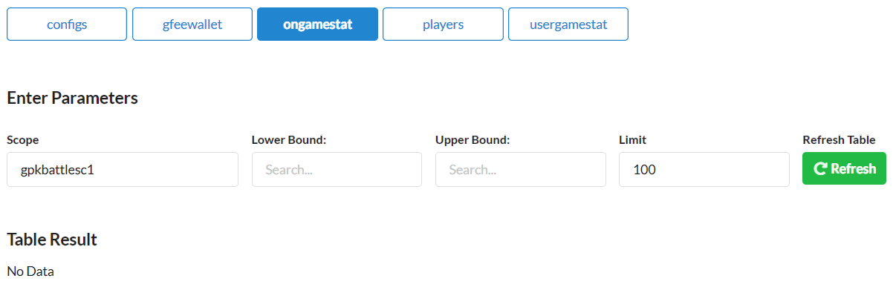
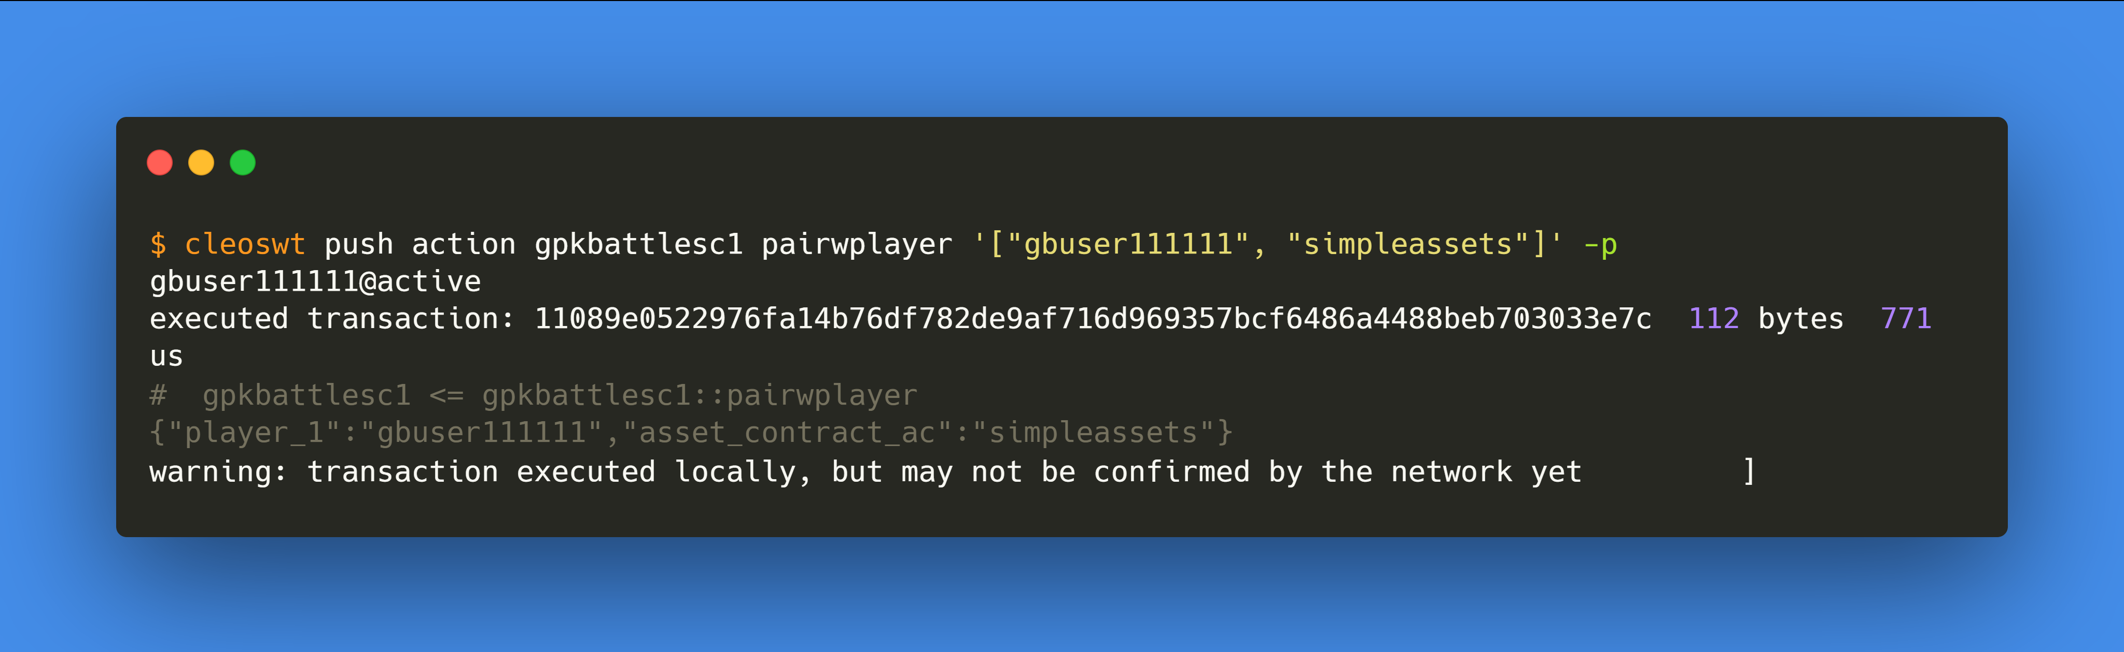
3.
gbuser111111
pairs with a player
Pre
Activity
Post
players
players
ongamestat
ongamestat
gfeewallet
gfeewallet

Slide 8
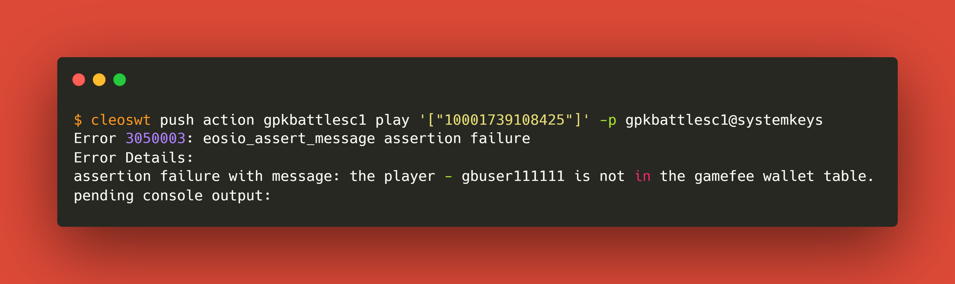
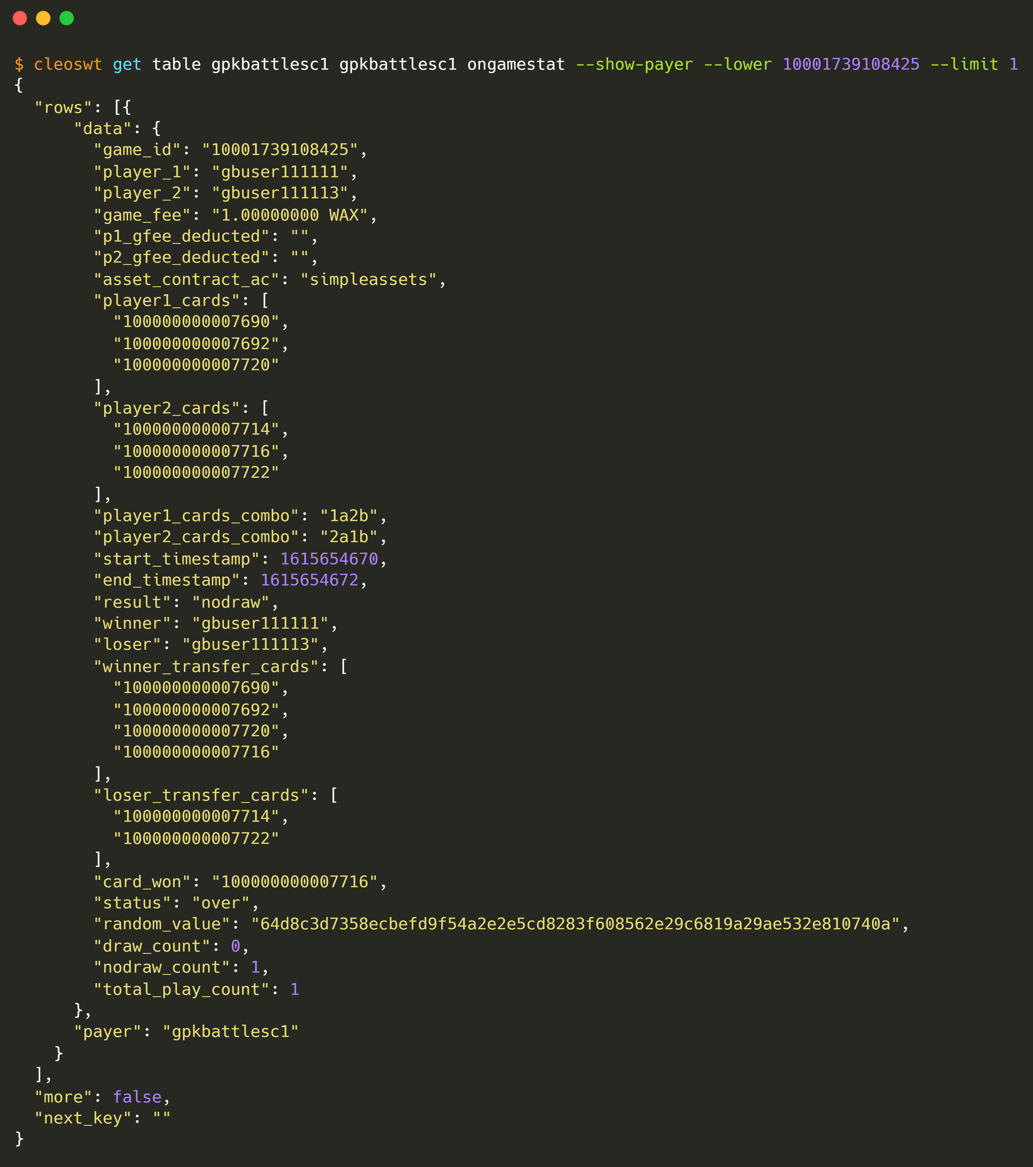

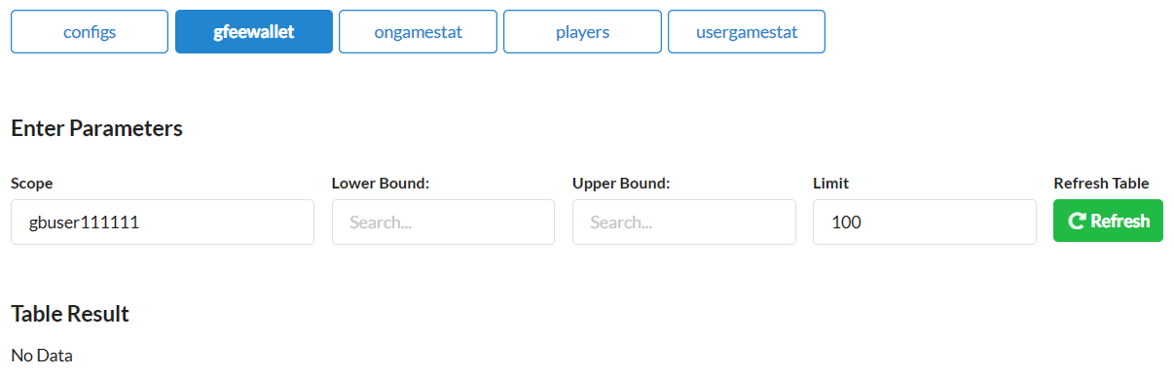
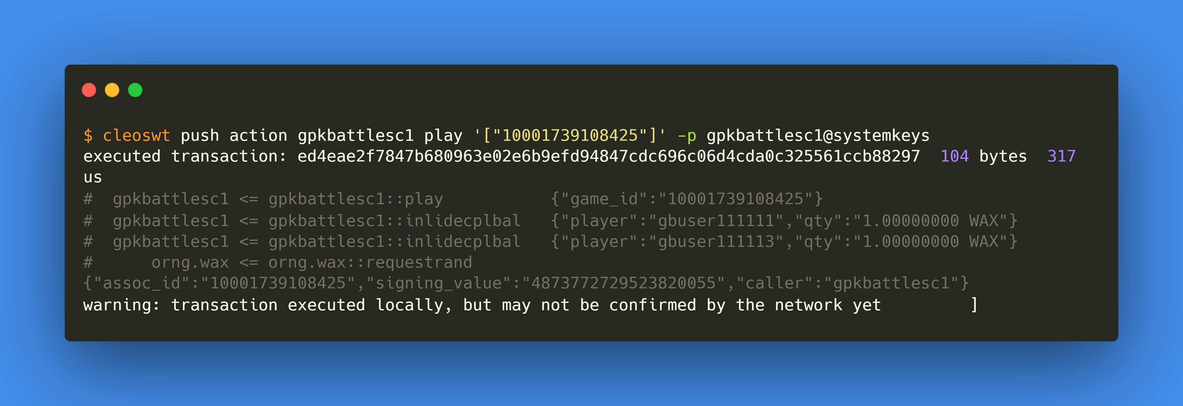
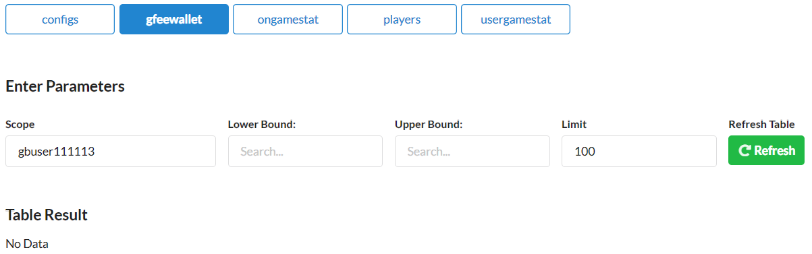
4.
gbuser111111
plays
Pre
Activity
Post
ongamestat
ongamestat
gfeewallet
gfeewallet

Slide 9
RUN-2

